Slide 1
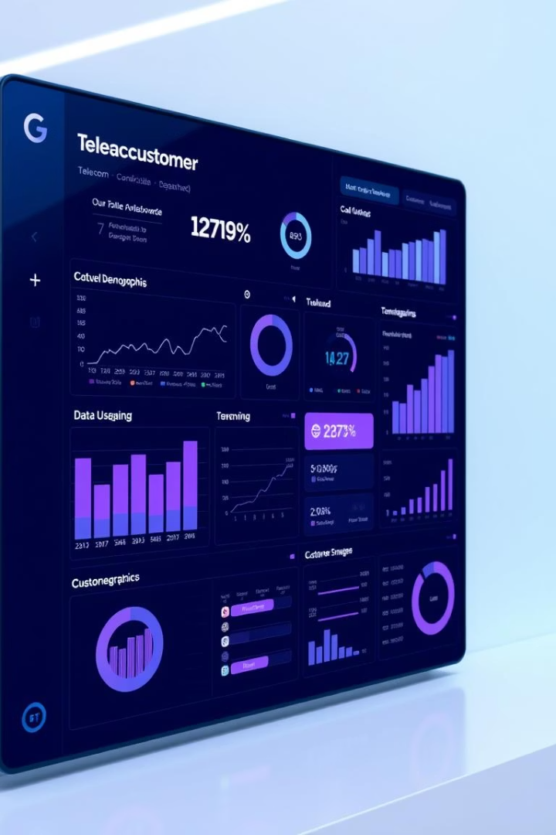

Customer Churn Prediction Project
This project aims to build a predictive model to identify telecom customers likely to churn using demographic and usage data. The goal is to help the company proactively retain valuable customers and improve service quality.
We will explore data preprocessing, exploratory data analysis, feature selection, model training, and evaluation using machine learning techniques.
by Shubham Raut

Slide 2
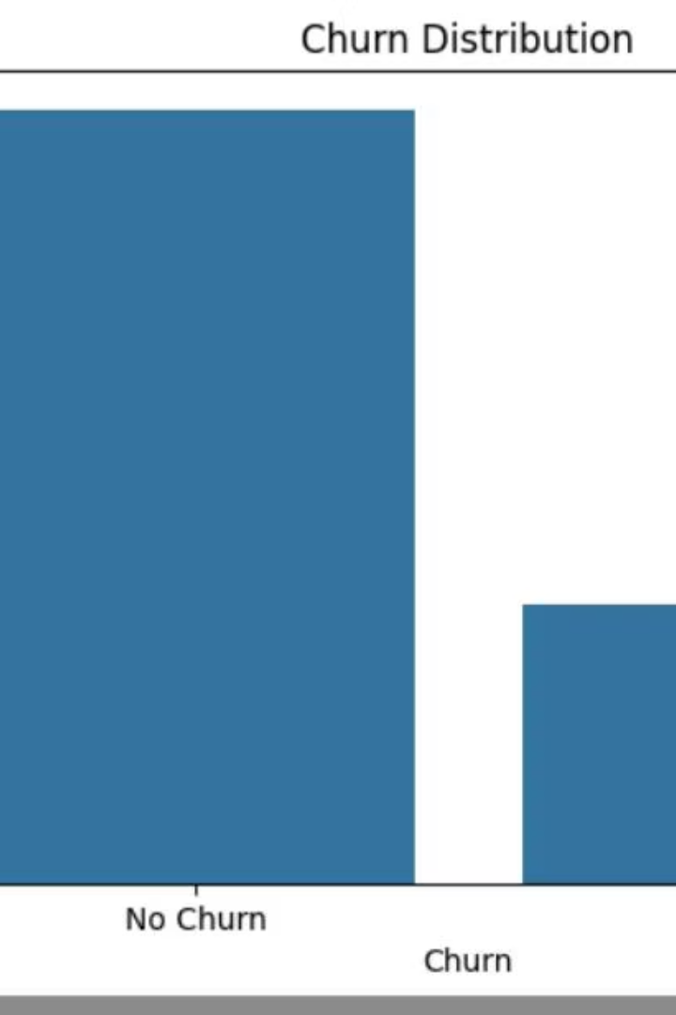
Data Overview and Preprocessing
Dataset Structure
Data Cleaning
The dataset contains 7,043 entries with 21 columns including demographics, services, and churn status.
Missing values in 'TotalCharges' were converted to numeric and filled with median values.
Preprocessing Steps
Unnecessary columns dropped, categorical variables encoded, and numerical features scaled for modeling.

Slide 3

Exploratory Data Analysis: Churn Insights
Churn Distribution
Contract Type Impact
About 26.5% of customers churn, while 73.5% stay.
Customers with two-year contracts churn less compared to month-to-month contracts.

Slide 4
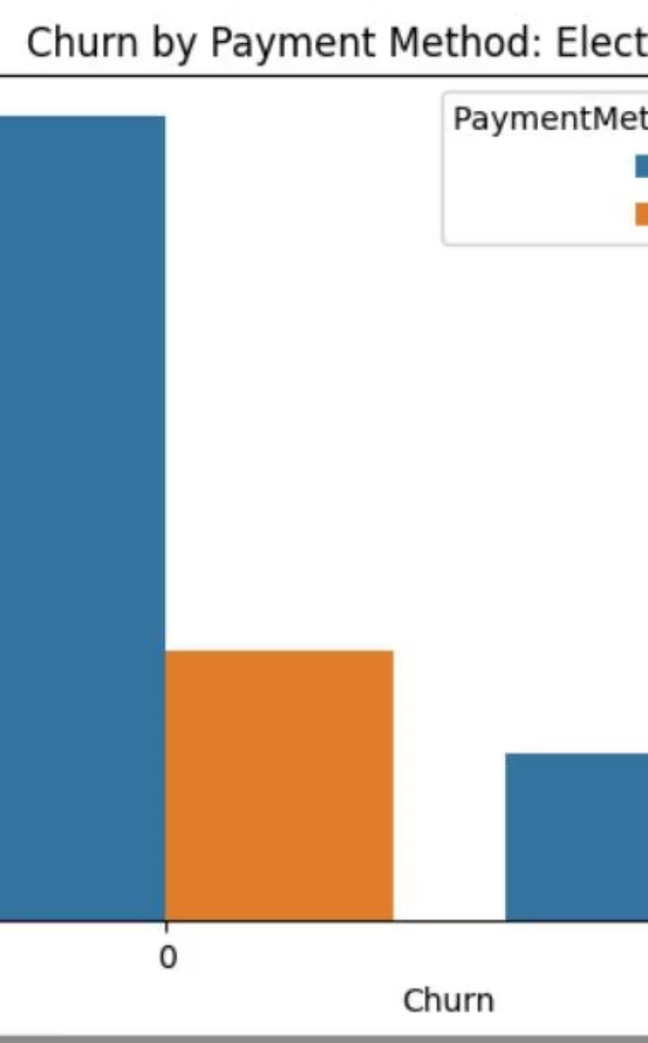
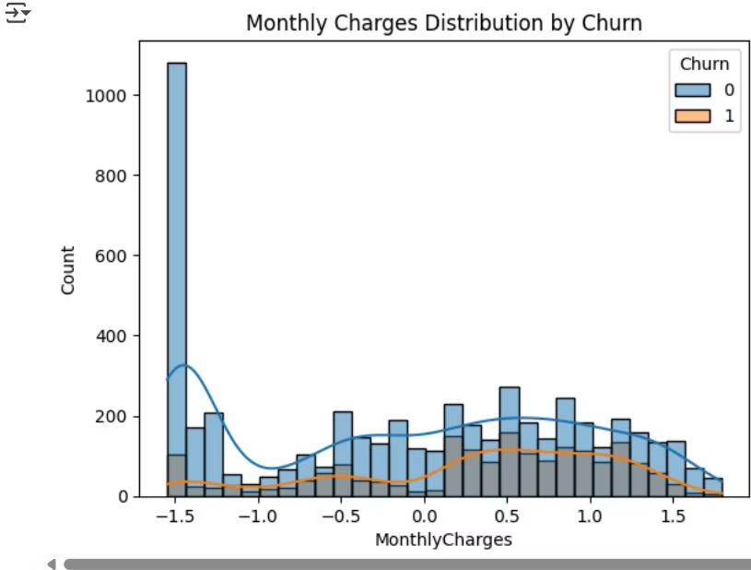
Payment Method and Charges Affect Churn
Electronic Check
Customers paying by electronic check have a higher churn rate.
Monthly Charges
Higher monthly charges correlate with increased likelihood of churn.

Slide 5
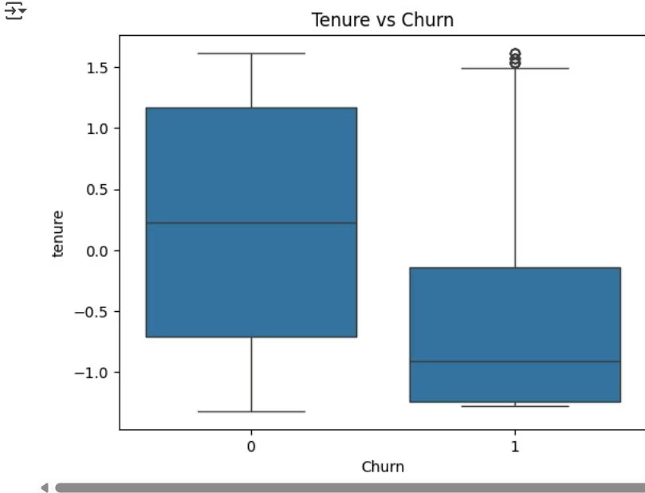
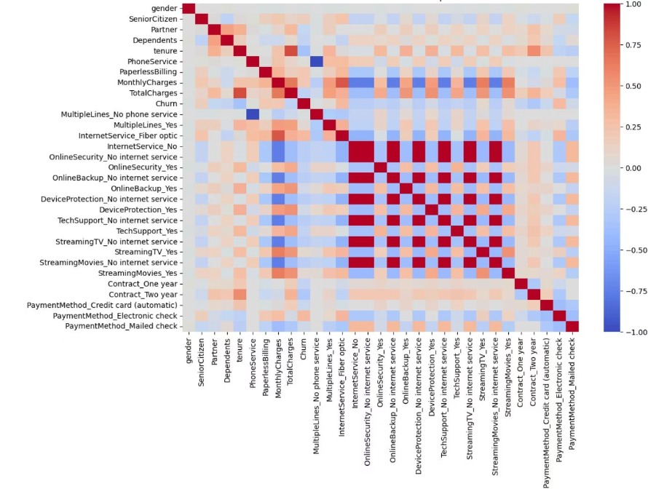
Tenure and Feature Correlations
Tenure Effect
Feature Correlation
Customers with shorter tenure are more likely to churn, indicating early churn risk.
Heatmap analysis reveals relationships among features impacting churn prediction.

Slide 6

Model Training and Evaluation: Random Forest
1
Random Forest Accuracy
2
Performance Metrics
Achieved 78.6% accuracy with balanced precision and recall.
Good precision for non-churn class; recall for churn class is lower, indicating room for improvement.

Slide 7
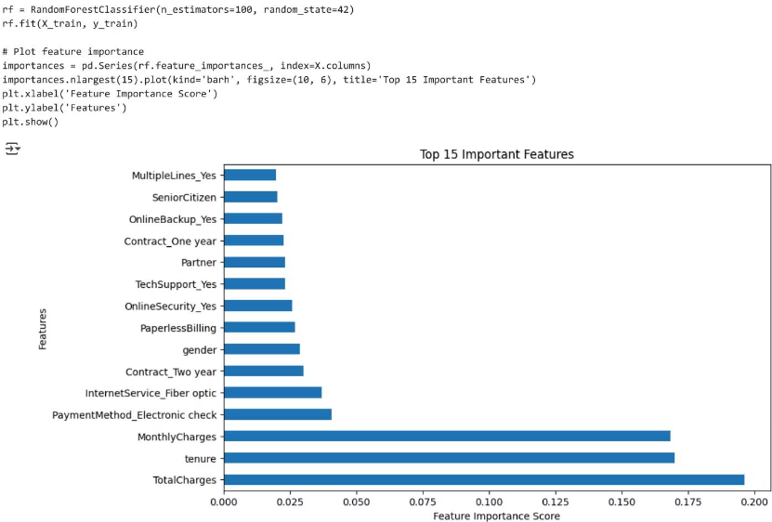
Model Training and Evaluation: XGBoost & Ensemble
XGBoost Model
Voting Classifier
Combining Random Forest and XGBoost improved accuracy slightly to 78.9%, enhancing model robustness.
XGBoost achieved 78.2% accuracy with similar performance to Random Forest.

Slide 8

Summary and Key Takeaways
Churn Drivers
Model Insights
Month-to-month contracts increase churn risk.
Random Forest, XGBoost, and ensemble models provide effective churn prediction with around 79% accuracy.
Electronic check payment method linked to higher churn.
Higher monthly charges and shorter tenure correlate with churn.
Next Steps
Use these insights to target retention efforts and improve customer service quality.

